Slide 1

Attention Mechanisms: Focusing on What Matters
Attention mechanisms are a crucial aspect of both biological and artificial intelligence systems. They allow for focusing on the most relevant information in complex environments, a skill that has been essential for the survival and success of primates, including humans.

Slide 2

The Evolutionary Significance of Attention
The primate visual system receives an overwhelming amount of sensory input. However, the brain's ability to focus on specific stimuli has been crucial for survival. This selective attention allows primates to identify potential prey or predators in complex visual environments.
The evolutionary advantage of attention lies in its ability to efficiently process vast amounts of information by concentrating on the most relevant aspects. This capability has been a key factor in human success and adaptation.
1
Sensory Input
Massive visual information received by the optic nerve
2
Selective Focus
Brain directs attention to objects of interest
3
Survival Advantage
Ability to identify prey and predators quickly
4
Evolutionary Success
Efficient information processing leads to human adaptation

Slide 3

Historical Context of Attention Studies
The study of attention in cognitive neuroscience dates back to the 19th century. Scientists have long been fascinated by how the brain selects and processes information from the environment. This rich history of research has laid the foundation for modern understanding of attention mechanisms.
Over time, various theories and models have been proposed to explain the cognitive processes underlying attention. These studies have contributed significantly to our current knowledge and have inspired the development of attention mechanisms in artificial intelligence.
19th Century
21st Century
Early studies on attention in cognitive science begin
Integration of attention concepts in AI and machine learning
1
2
3
20th Century
Development of various attention theories and models

Slide 4

Attention Cues in Visual Scenes
This framework identifies specific cues that guide attention, helping to understand how the brain prioritizes certain visual information over others.
By studying these attention cues, researchers have gained insights into the mechanisms of visual perception and cognition. These findings have significant implications for fields such as psychology, neuroscience, and computer vision.
Bottom-up Cues
Top-down Cues
Salient features that automatically draw attention
Goal-directed attention based on prior knowledge
Spatial Cues
Temporal Cues
Location-based attention deployment
Time-based attention shifts

Slide 5
Inspiration for Attention Models
The attention cues identified in cognitive neuroscience have inspired the design of attention models in machine learning. By mimicking the way human attention works, these models aim to improve the performance of artificial intelligence systems in tasks such as image recognition and natural language processing.
These biologically-inspired models demonstrate how insights from cognitive science can be applied to enhance machine learning algorithms, creating more efficient and effective AI systems.
Biological Attention
Machine Learning Models
AI Applications
Selective focus in human visual processing
Algorithms inspired by biological attention mechanisms
Improved performance in various AI tasks

Slide 6
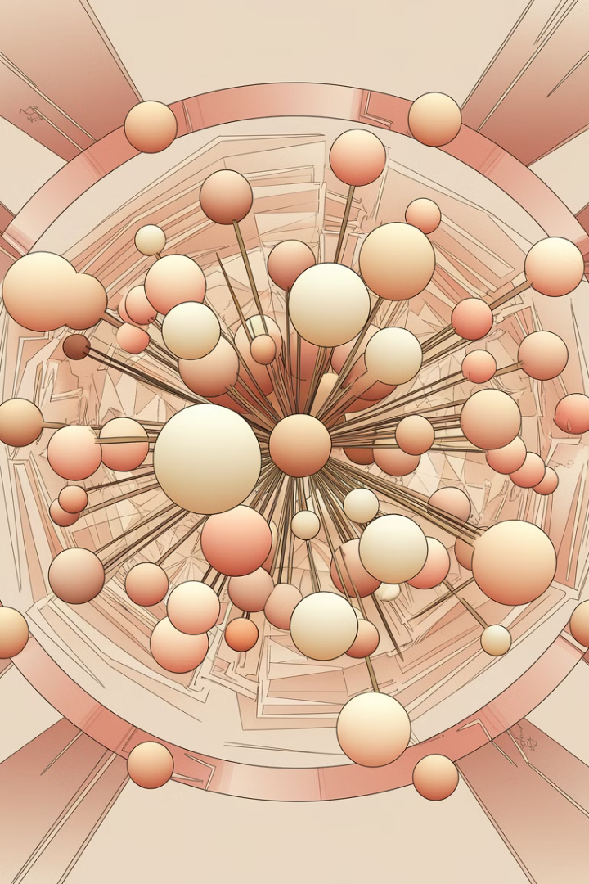




Nadaraya-Watson Kernel Regression
The Nadaraya-Watson kernel regression, developed in 1964, serves as a simple yet powerful demonstration of machine learning with attention mechanisms. This statistical method uses a weighted average to make predictions, where the weights are determined by the similarity between data points.
This approach can be seen as an early form of attention in machine learning, as it gives more importance (attention) to data points that are more similar to the point of interest. The Nadaraya-Watson kernel regression laid the groundwork for more complex attention models in modern deep learning.
Input Data
Collection of data points
Kernel Function
Measures similarity between points
Weighted Average
Calculates prediction based on similarities
Output
Regression estimate

Slide 7
Attention Functions in Deep Learning
This chapter introduces various attention functions that have become integral to the design of attention models in deep learning. These functions determine how much attention should be paid to different parts of the input data, allowing the model to focus on the most relevant information for a given task.
Attention functions have revolutionized many areas of deep learning, particularly in sequence-to-sequence tasks like machine translation and image captioning. They enable models to dynamically focus on different parts of the input as needed, leading to significant improvements in performance.
1
Additive Attention
2
Dot-Product Attention
Uses a feed-forward network to compute attention weights
Computes attention weights using dot products of queries and keys
3
Scaled Dot-Product Attention
4
Multi-Head Attention
Adds a scaling factor to improve stability in high dimensions
Applies attention multiple times in parallel for richer representations

Slide 8
Bahdanau Attention: A Breakthrough
The Bahdanau attention model, introduced in 2014, marked a significant advancement in the field of deep learning. This groundbreaking model introduced the concept of "soft" attention, allowing the model to focus on different parts of the input sequence when generating each part of the output sequence.
Bahdanau attention is particularly notable for its ability to align bidirectionally and its differentiable nature, making it suitable for end-to-end training. This model has been widely adopted in various sequence-to-sequence tasks, especially in machine translation.
1
Input Sequence
Encoder processes the input
2
Attention Computation
Calculate attention weights for each input element
3
Context Vector
Weighted sum of input based on attention
4
Output Generation
Decoder uses context to produce output

Slide 9





Multi-Head Attention: Parallel Processing
Multi-head attention is an extension of the attention mechanism that allows the model to jointly attend to information from different representation subspaces. Instead of performing a single attention function, multi-head attention performs the attention mechanism multiple times in parallel.
This approach enables the model to capture different aspects of the input simultaneously, leading to richer representations and improved performance. Multi-head attention has become a key component in many state-of-the-art models, particularly in natural language processing tasks.
Multiple Perspectives
Captures different aspects of input
Parallel Processing
Computes attention in parallel
Rich Representations
Combines multiple attention outputs
Improved Performance
Enhances model capabilities

Slide 10




Self-Attention: Relating Different Positions
Self-attention, also known as intra-attention, is a mechanism where the model attends to different positions within the same input sequence. This allows the model to compute representations of the input by relating different positions to each other, regardless of their distance in the sequence.
Self-attention has proven particularly effective in capturing long-range dependencies in sequences, a task that traditional recurrent neural networks often struggle with. It has become a fundamental building block in many modern deep learning architectures, especially in natural language processing.
Input Sequence
Self-Attention Computation
Weighted Sum
Output Representation
Sequence of elements
Combine information based on attention weights
Contextualized representation of each element
Relate each element to every other element

Slide 11
Positional Encoding: Preserving Order
In self-attention and other attention-based models, the order of elements in the input sequence is not inherently considered. To address this, positional encoding is introduced to inject information about the position of each element in the sequence.
Positional encoding allows the model to make use of the sequence order without sacrificing the benefits of parallelization. Various methods of positional encoding have been proposed, including sinusoidal functions and learned embeddings, each with its own advantages in different contexts.
Absolute Encoding
Relative Encoding
Learned Encoding
Assigns unique codes based on absolute position
Encodes relative distances between elements
Allows model to learn optimal position representations

Slide 12

The Transformer Architecture
The Transformer architecture, introduced in 2017, is a groundbreaking model that relies solely on attention mechanisms, dispensing with recurrence and convolutions entirely. This architecture has revolutionized the field of natural language processing and has since been adapted for various other domains.
Transformers use self-attention to process input sequences, allowing for efficient parallel computation and better modeling of long-range dependencies. The architecture consists of an encoder-decoder structure, with each component composed of multiple layers of self-attention and feed-forward neural networks.
Encoder
Processes input sequence
Decoder
Generates output sequence
Multi-Head Attention
Core attention mechanism
Feed-Forward Networks
Additional processing layers

Slide 13





Applications of Transformers
Since their introduction, Transformers have been widely adopted across various domains of artificial intelligence. Their versatility and effectiveness have led to significant advancements in multiple areas of deep learning applications.
Transformers have shown remarkable performance in natural language processing tasks such as machine translation, text summarization, and question answering. They have also been successfully applied to computer vision tasks, speech recognition, and even reinforcement learning, demonstrating their adaptability across different modalities.
Natural Language Processing
Translation, summarization, question answering
Computer Vision
Image classification, object detection
Speech Processing
Speech recognition, voice synthesis
Reinforcement Learning
Game playing, robotics

Slide 14
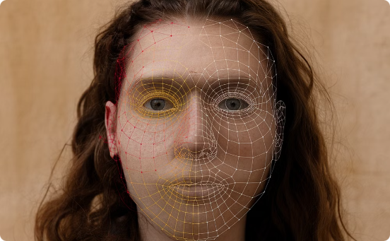


Attention in Computer Vision
While attention mechanisms were initially developed for natural language processing tasks, they have also found significant applications in computer vision. Attention in vision models allows the network to focus on specific regions of an image or video that are most relevant to the task at hand.
Visual attention mechanisms have been successfully applied to tasks such as image captioning, where the model needs to focus on different parts of the image to generate descriptive text. They have also been used in object detection and image classification tasks, improving the model's ability to identify and localize objects within complex scenes.
Object Recognition
Image Captioning
Object Detection
Attention highlights key features for classification
Model focuses on relevant image regions while generating text
Attention mechanism improves localization of objects

Slide 15

Attention in Speech Processing
Attention mechanisms have also made significant contributions to the field of speech processing. In tasks such as speech recognition and voice synthesis, attention allows models to focus on relevant parts of the audio signal or linguistic features.
For speech recognition, attention helps align the audio input with the corresponding text output, improving transcription accuracy. In text-to-speech systems, attention mechanisms enable more natural-sounding synthesis by allowing the model to focus on different aspects of the input text when generating each part of the speech output.
1
Audio Input
Process raw speech signal
2
Feature Extraction
Identify key acoustic features
3
Attention Mechanism
Focus on relevant features or time steps
4
Output Generation
Produce text transcription or synthesized speech

Slide 16

Attention in Reinforcement Learning
Attention mechanisms have also found applications in reinforcement learning, where they can help agents focus on relevant aspects of their environment or action space. This is particularly useful in complex environments with high-dimensional state spaces.
In game-playing AI, attention can help the agent focus on important game elements or strategic considerations. In robotics, attention mechanisms can assist in identifying relevant objects or areas in the robot's environment for more efficient decision-making and action planning.
State Attention
Focus on relevant aspects of the environment
Action Attention
Prioritize important actions in large action spaces
Temporal Attention
Attend to relevant past experiences for decision-making
Multi-Agent Attention
Focus on important agents in multi-agent systems

Slide 17
Challenges in Attention Mechanisms
While attention mechanisms have led to significant advancements in various AI tasks, they also come with their own set of challenges. One major issue is the computational complexity, especially for long sequences, as the attention computation typically scales quadratically with sequence length.
Another challenge is the interpretability of attention weights. While attention can provide some insight into which parts of the input the model is focusing on, it's not always straightforward to interpret these weights, especially in complex models with multiple layers of attention.
1
Computational Complexity
2
Interpretability
Quadratic scaling with sequence length poses efficiency challenges
Understanding and explaining attention weights can be difficult
3
Overfitting
4
Domain Adaptation
Attention mechanisms may lead to overfitting in some cases
Transferring attention models across domains can be challenging

Slide 18
Efficient Attention Mechanisms
To address the computational challenges of attention mechanisms, researchers have developed various efficient attention methods. These approaches aim to reduce the computational and memory complexity of attention, especially for long sequences.
Some popular efficient attention methods include sparse attention, which only computes attention for a subset of all possible pairs, and linear attention, which reduces the complexity from quadratic to linear. These methods enable the application of attention to longer sequences and larger datasets.
Sparse Attention
Linear Attention
Local Attention
Computes attention for a subset of pairs, reducing complexity
Reduces complexity from quadratic to linear
Focuses on local context to reduce computation

Slide 19



Attention in Multimodal Learning
Attention mechanisms have proven particularly effective in multimodal learning tasks, where the model needs to process and integrate information from multiple types of data, such as text, images, and audio. In these scenarios, attention helps the model focus on relevant aspects of each modality and their interactions.
For example, in visual question answering, attention allows the model to focus on relevant parts of an image based on the textual question. In video captioning, attention can help the model attend to important visual and audio cues when generating descriptive text.
Visual Question Answering
Video Captioning
Multimodal Sentiment Analysis
Attention focuses on relevant image regions based on text query
Model attends to important visual and audio cues
Attention integrates information from multiple modalities

Slide 20





Attention in Graph Neural Networks
Attention mechanisms have also been successfully applied to graph neural networks (GNNs), enhancing their ability to process and learn from graph-structured data. In this context, attention allows nodes to selectively attend to their neighbors, weighing the importance of different connections.
Graph attention networks (GATs) use attention to compute dynamic weights for aggregating information from neighboring nodes. This approach has shown improvements in various graph-based tasks, such as node classification, link prediction, and graph classification.
Node Features
Initial node representations
Attention Computation
Calculate attention weights for neighbors
Weighted Aggregation
Combine neighbor information based on attention
Updated Node Representation
New features incorporating neighborhood information

Slide 21

Attention in Time Series Analysis
Attention mechanisms have been successfully applied to time series analysis, enhancing the ability of models to capture long-term dependencies and focus on relevant historical information. In this domain, attention allows models to selectively focus on important time steps or features when making predictions or classifications.
For tasks such as time series forecasting, attention can help the model identify and leverage relevant historical patterns. In anomaly detection, attention mechanisms can assist in focusing on unusual patterns or deviations from normal behavior.
1
Historical Data
Past time series values
2
Attention Computation
Determine relevance of past time steps
3
Context Vector
Weighted sum of historical information
4
Prediction
Generate forecast or classification

Slide 22
Cross-Lingual Attention
In the field of machine translation and multilingual natural language processing, cross-lingual attention has emerged as a powerful technique. This approach allows models to attend to words or phrases in one language while processing or generating text in another language.
Cross-lingual attention has been particularly effective in improving the quality of machine translation systems, enabling more accurate alignment between source and target languages. It has also been applied to tasks such as cross-lingual information retrieval and multilingual text classification.
Source Language
Cross-Lingual Attention
Target Language
Input text in original language
Align words/phrases across languages
Generated text in target language

Slide 23
Attention in Generative Models
Attention mechanisms have played a crucial role in improving generative models, particularly in tasks involving sequential data generation. In text generation, attention allows the model to focus on relevant parts of the input or previously generated text when producing each new word or phrase.
In image generation tasks, spatial attention mechanisms enable models to focus on specific regions when generating different parts of an image. This has led to improvements in the coherence and quality of generated images, especially in conditional generation tasks.
Text Generation
Image Generation
Focus on relevant context for coherent text
Attend to spatial regions for detailed images
Music Generation
Video Generation
Attention to musical structure and patterns
Temporal and spatial attention for coherent videos

Slide 24





Attention in Recommender Systems
Attention mechanisms have been successfully applied to recommender systems, enhancing their ability to capture user preferences and item characteristics. In this context, attention allows the model to focus on the most relevant aspects of a user's history or an item's features when making recommendations.
For example, in session-based recommendation, attention can help the model focus on the most relevant items from the user's current session. In content-based recommendation, attention mechanisms can identify the most important features of items that align with user preferences.
User Modeling
Attend to relevant user behaviors
Item Representation
Focus on important item features
Historical Interactions
Weigh importance of past user-item interactions
Recommendation Generation
Combine attended information for personalized suggestions

Slide 25


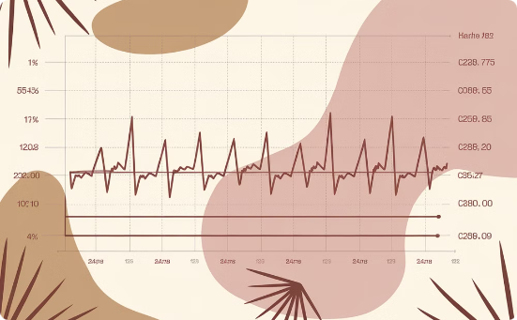
Attention in Healthcare AI
Attention mechanisms have found valuable applications in healthcare AI, particularly in tasks involving medical imaging and electronic health records (EHR) analysis. In medical image analysis, attention helps models focus on relevant regions or features, improving diagnostic accuracy.
For EHR analysis, attention mechanisms allow models to focus on the most relevant parts of a patient's medical history when making predictions or recommendations. This has led to improvements in tasks such as disease prediction, treatment recommendation, and patient risk stratification.
Medical Imaging
EHR Analysis
Patient Monitoring
Attention focuses on relevant anatomical features
Model attends to crucial elements of patient history
Attention identifies important changes in patient condition

Slide 26
Explainable AI and Attention
Attention mechanisms have contributed significantly to the field of explainable AI, providing a means to interpret and visualize the decision-making process of deep learning models. By examining attention weights, researchers and practitioners can gain insights into which parts of the input the model is focusing on when making predictions or decisions.
However, it's important to note that while attention weights can provide valuable insights, they should not be considered as definitive explanations of model behavior. Ongoing research is exploring more robust methods for leveraging attention in explainable AI.
1
Attention Visualization
2
Feature Importance
Graphical representation of attention weights
Identifying crucial input elements for predictions
3
Decision Tracing
4
Interpretability Challenges
Following attention patterns through model layers
Addressing limitations in attention-based explanations

Slide 27





Future Directions in Attention Research
As attention mechanisms continue to evolve, several promising research directions are emerging. One area of focus is the development of more efficient attention methods to handle increasingly large datasets and models. Another is the exploration of novel attention architectures that can capture more complex relationships in data.
Researchers are also investigating the integration of attention with other AI techniques, such as reinforcement learning and causal inference. Additionally, there's growing interest in developing attention mechanisms that can operate across multiple modalities and time scales simultaneously.
Efficient Attention
Scaling to larger datasets and models
Novel Architectures
Capturing more complex relationships
Cross-Modal Attention
Integrating information across different data types
Causal Attention
Incorporating causal reasoning into attention mechanisms

